Slide 1
Youth Homeless Demonstration Program (YHDP)
Data Collection and Entry Training
2023

Slide 2
Introductions
Name
Agency
Role
HMIS*, database or data entry experience
* Homeless Management Information System

Slide 3
Housekeeping
Logistics
  • 2.5-hour training session
  • Please stay muted, unless you would like to ask a question
  • Your undivided attention is required:
      Close email and other programs for the best quality
      Silence your phone, do not answer text messages
      Shut the office door
      Inform your staff you are not available during this time
Asking questions
• This training session is for you, so ask questions at anytime, or type your questions
• If you ask questions that are not answered, they will be answered after we review them with our vendor, the Partnership Center or we will ask HUD.
Notes:
The webinar software does record if your active in the session or not. If you are not able to complete the session, we will ask you to register for another session.

Slide 4
Housekeeping - continued
EA Family Shelters will continue to use ETO
HMIS/ETO "Blackout" was Wednesday, September 29, 2021 @ 5pm
HMIS data entry started in VESTA Live Monday, October 4, 2021

Slide 5
Training Objectives
Attendees will learn:
  About the HMIS Data Standards for FY2024
  Confidentiality, Privacy and Security Training
  How to Navigate the VESTA HMIS system
    Record a client entry, RHY Service, update, annual assessment, and exit from a project
    Run basic reports
    Troubleshoot common issues that can cause problems for reporting, if time
Notes:
Poll question What project type(s) do you enter for?

Slide 6
Agenda
Overview
  • The FY2024 HMIS Data Standards
  • Confidentiality, Privacy and Security Training
  • Expectations for all users - Data Quality & Data timeliness
  • Support System overview and who to contact for help
VESTA Live Demonstration
  • Data collection overview for your project type(s)
  • Dashboard, client entry
  • HUD data collection including Disability, Cash/non-cash, Health Insurance
  • Updates and Annual Assessment
  • RHY Services
  • Report basics
Notes:
Poll question What project type(s) do you enter for?

Slide 7
New FY2024 HMIS Data Standards and Manuals
HUD Go Live October 1, 2023
FY2024 HMIS Data Standards
HMIS Federal Partner Program Manuals
HMIS Data Standards - HUD Exchange
Notes:
HMIS Data Standards - HUD Exchange

Slide 8
What is HMIS?
Homeless Management Information System
Locally administered, electronic data collection
Used to record and analyze data about clients, service and housing for individuals and families who are homeless or at risk of homelessness
HUD developed with federal partners

Slide 9
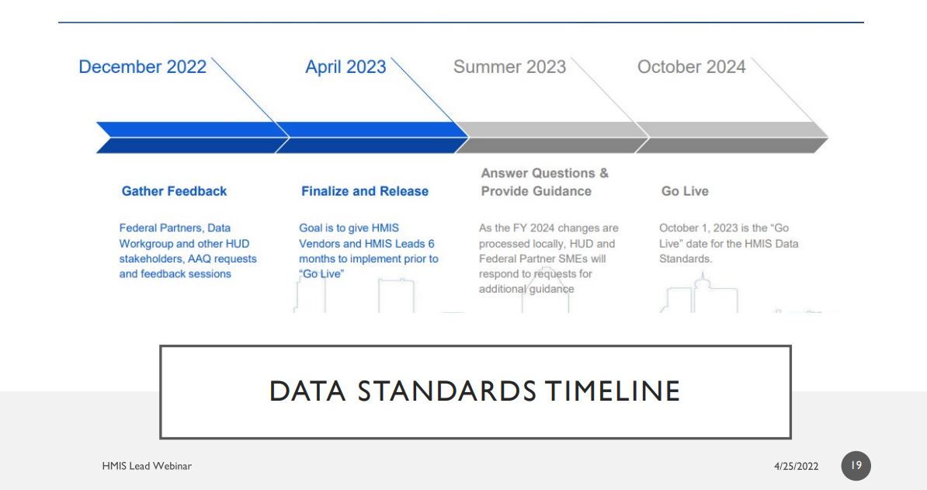
HMIS Data Standards FY2024
October 2023

Slide 10
Youth Homelessness Demonstration Program
Youth Homelessness Demonstration Program (YHDP): YHDP is a HUD developed and funded initiative
The goal of the YHDP is to support selected communities, including rural, suburban, and urban areas across the United States, in the development and implementation of a coordinated community approach to preventing and ending youth homelessness
Additionally, HUD is committed to sharing that experience of YHDP communities and mobilizing communities around the country toward the same end

Slide 11
YHDP-funded projects homeless categories
Unlike the CoC Program, YHDP-funded projects may be permitted to serve persons in any of the four categories in the definition of homelessness.
Literally Homeless category 1
Individual or family who lacks a fixed, regular, and adequate nighttime residence, meaning:
Has a primary nighttime residence that is a public or private place not meant for human habitation; or
Is living in a publicly or privately operated shelter designated to provide temporary living arrangements (including congregate shelters, transitional housing, and hotels and motels paid for by charitable organizations or by federal, state and local government programs); or
Is exiting an institution where (s)he has resided for 90 days or less and who resided in an emergency shelter or place not meant for human habitation immediately before entering that institution.
Note: An individual or family only needs to meet one of the three subcategories to qualify as Homeless Category 1: Literally Homeless.

Slide 12
YHDP-funded projects category 2
Imminent Risk of Homelessness
An individual or family who will imminently lose their primary nighttime residence, provided that:
Residence will be lost within 14 days of the date of application for homeless assistance;
No subsequent residence has been identified; and
The individual or family lacks the resources or support networks needed to obtain other permanent housing.
Note: Includes individuals and families who are within 14 days of losing their housing, including housing they own, rent, are sharing with others, or are living in without paying rent.

Slide 13
YHDP-funded projects category 3
Homeless Under Other Federal Statutes
Unaccompanied youth under 25 years of age, or families with Category 3 children and youth, who do not otherwise qualify as homeless under this definition, but who:
Are defined as homeless under the other listed federal statutes;
Have not had a lease, ownership interest in permanent housing during the 60 days prior to the homeless assistance application;
Have experienced persistent instability as measured by two moves or more during in the preceding 60 days; and
Can be expected to continue in such status for an extended period of time due to special needs or barriers

Slide 14
YHDP-funded projects category 4
Fleeing/Attempting to Flee Domestic Violence
Any individual or family who:
Is fleeing, or is attempting to flee, domestic violence;
Has no other residence; and
Lacks the resources or support networks to obtain other permanent housing
Note: “Domestic Violence” includes dating violence, sexual assault, stalking, and other dangerous or life-threatening conditions that relate to violence against the individual or family member that either takes place in, or him or her afraid to return to, their primary nighttime residence (including human trafficking)

Slide 15
YHDP-funded projects
All YHDP projects following the FY2024 Data Standards that are serving clients who meet the definition of homelessness in either Category 2 or 3 of the homeless definition must therefore collect 4.12 Current Living Situation, regardless of project type
This data is collected under the “Encounters” form in the client record

Slide 16
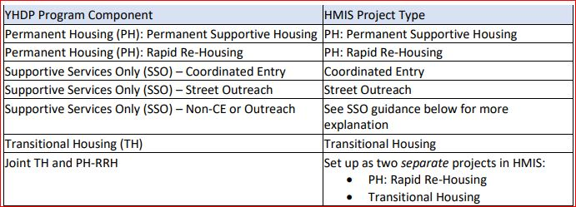
YHDP Program Component HMIS Project Type

Slide 17
Rapid Re-Housing (RRH)
PH: Rapid Re-Housing (RRH) provides housing relocation and stabilization services and short and/or medium-term rental assistance as necessary to help a homeless individual or family move as quickly as possible into permanent housing and achieve stability in that housing
YHDP RRH

Slide 18
Supportive Services Only (SSO) Non-CE or Outreach
The Supportive Services Only (SSO) component of the CoC program provides services to homeless individuals and families not residing in housing operated by the recipient. Funds may be used to conduct outreach to sheltered and unsheltered homeless persons and families, link clients with housing or other necessary services, and provide ongoing support.
YHDP Youth Navigator

Slide 19
Permanent Supportive Housing
PH: Permanent Supportive Housing offers permanent housing and supportive services to assist homeless persons with a disability (individuals with disabilities or families in which one adult or child has a disability) to live independently.

Slide 20
Supportive Services Only (SSO) – Street Outreach
Street Outreach - to provide regular/repeated contacts to youth experiencing homelessness to move them to engagement.
Contacts include the provision of basic needs and service referrals.
Engagement is defined as the youth’s willingness to develop a plan for moving out of homelessness

Slide 21
SSO Coordinated Entry
To provide a centralized or coordinated process designed to coordinate program participant intake assessment and provision of referrals
It should be noted that CoCs with HUD-funded SSO Coordinated Entry (SSO-CE) projects are required to collect CE data elements

Slide 22
Transitional Housing
Transitional Housing (TH): When placed in TH the housing is intended to be a shorter-term duration and not permanent

Slide 23
Joint RRH and PSH component project
The Joint RRH and PSH component project includes two existing program components – RRH and PSH two separate projects to serve individuals and families experiencing homelessness

Slide 24
YHDP Data Collection Requirements
Universal Data Elements (UDE) - are client level data elements required for collection by all projects participating in HMIS, regardless of project type or funding.
Common Data Elements - are collected by most projects funded by a federal partner
Program Specific Data Elements - are collected by program type

Slide 25
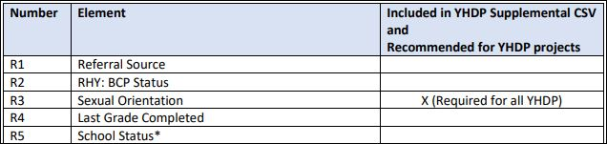
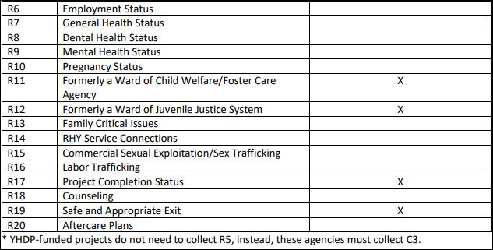
YHDP Data Collection Requirements

Slide 26
Data Collection Stages
• Search – look for client in the system to avoid duplicate entries
• Project Start – when they begin a program
• RHY Services - when they receive services
• Update – when an element changes (e.g., income) with the information date identifying the date the data is collected or was relevant
• Annual Assessment- for all persons in the project one year or more, with an Information Date of no more than 30 days before or after the one-year anniversary of the head of household’s Project Start Date, regardless of the date of the most recent ‘update’ or any other ‘annual assessment.’
• Project Exit - date of exit*
*Includes Project Completion Status and Safe and Appropriate Exit

Slide 27
HMIS Data collection - Universal Data Elements
  Universal Identifier Elements (One and Only One per Client Record)
    • 3.01 Name
    • 3.02 Social Security Number
    • 3.03 Date of Birth
    • 3.04 Race
    • 3.05 Ethnicity
    • 3.06 Gender
    • 3.07 Veteran Status

Slide 28
HMIS Data collection - Universal Data Elements
  One or More Value(s) Per Client or Household Project Stay
    • 3.08 Disabling Condition
    • 3.10 Project Start Date
    • 3.11 Project Exit Date
    • 3.12 Destination
    • 3.15 Relationship to Head of Household
    • 3.16 Client Location
    • 3.917 Living Situation
    • 3.20 Housing move-in date (PH/RRH only)

Slide 29
HMIS Data collection - Universal Data Elements
3.08 Disabling Condition
•Related to Special Needs Elements
•Will default “yes”, if otherwise has a disabling condition that affects ability to live independently

Slide 30
HMIS Data collection - Universal Data Elements
3.10, 3.11 When To Enter and Exit client
  • Project Start
  • Start Date will be the first date the youth enters the program
  • Exit Date will be the date the youth is referred to another program or after a period of no-contact

Slide 31
3.11 Project Exit Date
The purpose of the project exit date is to determine the end of a client’s period of participation with a project
All projects need this data element for reporting; residential continuum projects need it to measure lengths of stay, and other projects need it to determine the amount of time spent participating in the project

Slide 32
HMIS Data collection - Universal Data Elements
3.12 Destination
• Very important! Select the destination that best matches where the youth is going
  School, military, and similar institutions, select ‘Rental by client –no ongoing subsidy’ (subsidy refers to voucher/rental assistance, but not room & board assistance)
• Destination: For family reunification would be entered as “Staying or living with family, permanent tenure.”
•‘Other’ is a negative exit, so only use as last resort
•If the youth is exited after a period of no-contact, select ‘No exit interview completed’ this is a negative exit

Slide 33
HMIS Data collection - Universal Data Elements
3.15 Relationship to Household
  • Each unaccompanied youth is a Head of Household (“Self”)
  • Youth with child(ren): The youth is a Head of Household (“Self”) and the child(ren) is “Head of Household’s Child”
  • Youth presenting together (such as siblings or partners) would each be considered their own Head of Household each person should be entered as their own record in their own household

Slide 34
HMIS Data collection - Universal Data Elements
3.16 Client Location
  •CoC Code: MA-516
  System will default to the correct location

Slide 35
HMIS Data collection - Universal Data Elements
3.917 Prior Living Situation
To identify the type of living situation and length of stay in that situation just prior to project start
for all adults and heads of households
Intake staff should ask clients about their homeless history, including specific instances the client spent on the street, in an Emergency Shelter, or in a Safe Haven project. This may require defining or explaining each field to the client.

Slide 36
HMIS Data collection - Universal Data Elements
3.20 Housing move-in date (RRH & PH only)
To identify the type of living situation and length of stay in that situation just prior to project start
for all adults and heads of households
Intake staff should ask clients about their homeless history, including specific instances the client spent on the street, in an Emergency Shelter, or in a Safe Haven project. This may require defining or explaining each field to the client.

Slide 37
Required Data Elements
YHDP-funded projects must collect the common data elements necessary to generate the Annual Performance Report (APR)

Slide 38
HMIS Data collection - Common Data Elements
4.02 Income and Sources
4.03 Non-Cash Benefits
4.04 Health Insurance
4.05 Physical Disability
4.06 Developmental Disability
4.07 Chronic Health Condition
4.08 HIV/AIDS
4.09 Mental Health Disorder
4.10 Substance Use Disorder
4.11 Domestic Violence
4.12 Current Living Situation
4.13 Date of Engagement
4.14 Bed-night date
4.19 Coordinated Entry Assessment
4.20 Coordinated Entry Event

Slide 39
HMIS Data collection - Common Data Elements
4.02 Income and Sources
Collect income information, projects are expected to ask clients whether they receive income from each of the source's list rather than asking them to state the sources of income they receive.
Project Start, Update, Annual Assessment and Exit

Slide 40
Program Specific Element - R3 Sexual Orientation
Information is to be collected at Project Start, but you may ask and correct at any point after building rapport. This question is voluntary, and the youth must be informed about the voluntary nature of this question. Refusal to answer cannot result in a denial of services. It is expected this field will be updated as trust is built with the client.
The response options include Heterosexual, Gay, Lesbian, Bisexual, Questioning/Unsure, Other, Client doesn’t
know, and Client refused. Any questions regarding a client’s sexual orientation must be voluntary and clients
must be informed prior to responding of the voluntary nature of the question and that their refusal to respond will not result in a denial of services. It is important that this measure be updated if a youth discloses this information at a later time when a trusting relationship is established. In the case of “pansexual” or “asexual” or other options that may not be listed, select "Other" and describe the “Other” response in a separate text response option should the client choose to provide a response to this question

Slide 41
Program Specific Element - C3 Youth Education Status
C3 Youth Education Status is required by the FY2022 Data Standards for YHDP
This element is collected for heads of household at enrollment to and exit from the project in order to determine the both the education level of youth served in YHDP projects as well as any changes or gains in their education level
The purpose of this element is to determine whether youth heads of household are accessing educational programs at the time of project start and exit, and to allow for analyzing changes in education status of youth between project start and exit

Slide 42
Program Specific Elements
  R6 Employment Status - identify what type of employment, if any
  R7 General Health Status - identify what type of health services a client may need
  R8 Dental Status - help identify what type of health services a client may need
  R9 Mental Health Status - help identify what type of health services a client may need

Slide 43
Program Specific Elements
  R10 Pregnancy Status - Collect at Project Start, but may correct or update if you learn new information
  • Yes /No, If yes, enter due date or estimated due date. If unknown, enter January 1 of following year
  R11 Formerly a Ward of Child Welfare/Foster Care Agency - identify clients with child welfare or foster care histories
  R12 Formerly a Ward of Juvenile Justice System to identify clients with juvenile justice system responsibility histories
  R14 Service Connections to report on the services that they either directly provided youth

Slide 44
Program Specific Elements
  R17 Project Completion Status The purpose is to identify whether the youth completed the project or exited without completion. This data is only collected on heads of household and adults at project exit.
  R18 Counseling To identify the type and amount of counseling received
  R19 Safe and Appropriate Exit The purpose of this element is to determine the number of youth who exited to safe and appropriate destinations as determined by the youth (head of household and adult) themselves and as determined by the project/caseworker

Slide 45
Program Specific Element - RHY Services
  R14 Service Connections to report on the services that they either directly provided youth
  Community service/service learning (CSL)
  Criminal justice /legal services
  Education
  Employment and/or training services
  Health/medical care
  Home-based Services
  Life skills training
  Parenting education for youth with children
  Post-natal newborn care (wellness exams; immunizations)
  Post-natal care for mother
  Pre-natal care
  Substance abuse treatment
  Substance Abuse Ed/Prevention Services

Slide 46
Updates
Client updates should be used for updating client information such as changes in income, disability, insurance, or non-cash benefits
Client information should not be edited or changed in the entry unless the information was incorrect at project start, or Disability status changes
Changes in income are designated by ending the current income and adding the updated amount separately

Slide 47
Annual Assessment
For all Clients in the project one year or more, with an Information Date of no more than 30 days before or after the one-year anniversary of the head of household’s Project Start Date, regardless of the date of the most recent ‘update’ or any other ‘annual assessment’
Client annual assessments should be used for updating client information such as changes in income, disability, insurance, or non-cash benefits

Slide 48
HMIS Reporting timeline
APR: Cover the grant operating year. Due within 90 days from end of grant operating year
QPR: Follow federal fiscal quarters. Due within 30 days of the end of the fiscal quarter.
Two CSVs are required
  APR CSV report
  Hashed HMIS CSV (sometimes called the RHYHMIS)
YHDP Supplemental Reporting Tool
  Uses the Hashed HMIS CSV
  Contains demographics and RHY elements
  Aggregates data-intersectional
  All projects except for CE, HMIS, & Planning

Slide 49
HMIS data used in Federal Reporting
Quarterly and Annual Reporting-Project-level data. Primarily looking at housing, education, and income outcomes as well as financials
January 30th
April 30th
July 30th
October 30th

Slide 50
YHDP Quarterly Data Reporting
Quarterly Performance Reporting
YHDP recipients are required to submit an APR on a quarterly basis via CSV upload in the Sage HMIS Reporting Repository for each project awarded YHDP funds. Additional information about the Sage HMIS Reporting Repository can be found in the Sage CoC APR Guidebook
In addition to the typical CoC APR submission requirements in Sage, all YHDP-funded projects, except HMIS and planning grants, will be required to complete two additional YHDP-specific steps
1. Upload the YHDP Supplemental CSV
2. Complete the YHDP Supplemental Questions Form
HUD is also allowing communities that have identified additional performance measures to report the additional measure and outcomes in a narrative format

Slide 51
YHDP Annual Data Reporting
Annual Performance Reporting
YHDP recipients are required to submit an Annual Performance Report (APR) via CSV upload in the Sage HMIS Reporting Repository for each project awarded YHDP funds. Additional information about the Sage HMIS Reporting Repository can be found in the Sage CoC APR Guidebook
In addition to the typical CoC APR submission requirements in Sage, all YHDP-funded projects, except HMIS and planning grants, will be required to complete two additional YHDP-specific steps
1. Upload the YHDP Supplemental CSV
2. Complete the YHDP Supplemental Questions Form
HUD is also allowing communities that have identified additional performance measures to report the additional measure and outcomes in a narrative format

Slide 52
System Level Performance Reporting
YHDP-funded projects participate in CoC System Performance Reporting the same as any other CoC-funded project. Additionally, information about youth-specific system performance measures can be garnered via the Longitudinal System Analysis (LSA) report
Beyond these CoC system measures, YHDP projects are encouraged to utilize the Benchmarks and Criteria for ending homelessness among youth provided by the U.S. Interagency Council on Homelessness
These benchmarks and criteria remain under development, so YHDP communities and projects should watch for updates from HUD and USICH

Slide 53
Longitudinal System Analysis
System-level data like LSA but looks at how individuals move through the system, summary and year-to-year comparison of system wide counts, averages, and medians related to areas of performance

Slide 54
Support – How to get HMIS help
We have acquired a helpdesk system software, Zendesk. We went Live, March 2022.
Send email to support@vestama.zendesk.com
https://vestama.zendesk.com/hc/en-us
Kelly Schlabach, HMIS Lead Coordinator, Kelly.schlabach@mass.gov (617) 573-1387
Andrew Pape, ETO HMIS Coordinator, Andrew.pape@mass.gov (617) 573-1234
Donna Curley, HMIS Training Coordinator, Donna.Curley@mass.gov (617) 573-1399
Laura Robertson, HMIS Reporting Specialist, Laura.Robertson@mass.gov (617) 573-1378
Anthony Nappo, RDC Administrator, Anthony.Nappo@mass.gov (617) 573-1374

Slide 55
Available Resources
YHDP Program HMIS Manual
YHDP Community Resources
YHDP APR Guidance document

Slide 56
Questions
and
Answers

Slide 57

Next up
Notes:
GoTo next preso Poll question Does your Agency require you to take training on Client Confidentiality, Privacy and Security?
Privacy and security training link: https://youtu.be/C0f--OVw6Vc
Back up link: https://youtu.be/IREMIA6Z4ms

Slide 58
Break Time!
Stretch Break
Be back at 11:05am
Thank you!

Slide 59

Welcome to VESTA
Virtual Electronic Service Tracking Assistant
We can’t wait to show you how easy to use and awesome our new HMIS system is!
https://demo.vestama.net/
Notes:
Poll question Are you back from the break?

Slide 60
Thank you
for all you do
to help the
Homeless Youth

