Slide 1

Welcome to
VESTA CE Workflow
Training for EA Family Shelters
2025

Slide 2
Housekeeping
Logistics
  • 2-hour training session, approximately
  • Please stay muted, unless you would like to ask a question
  • Your undivided attention is required:
      Close email and other programs for the best quality
      Silence your phone, do not answer text messages
      Shut the office door
      Inform your staff you are not available during this time
Asking questions
• This training session is for you, so ask questions at anytime, or type your questions
• If you ask questions that are not answered, they will be answered after we review them with our HMIS team, vendor, or The Partnership Center
Notes:
The webinar software does record if your active in the session or not.

Slide 3
Training Objectives
Attendees will learn:
  How the CE workflow operates
  How to Navigate the VESTA HMIS system
    Record a client entry, Quick Screening, CE intake and CE assessment with Housing Preferences, and exit from project
    How to use the CE dashboard
    *CE training sessions are be available on an as needed basis

Slide 4
Coordinated Entry requirement
All CoC-funded PSH, TH-RRH, TH and RRH, and all ESG-funded RRH are required to participate
  Must receive all referrals via the proper Regional Navigator

Slide 5
Overview of Coordinated Entry (cont.)
​
Automation within VESTA:​
  Prioritizes participants by vulnerability​
  Matches participants by project eligibility requirements & participant preference​
  Auto-exits CE applicants who are inactive or housed
  BoSCoC CE Policies and Procedures link

Slide 6
EA CE Process in VESTA
All BoS CoC funded EA Family shelters have their projects in VESTA and the data is imported into VESTA nightly
EA Case Manager trained to do CE Quick Screen and CE Assessment would identify family in the EA shelter with an adult that has a disability and meets CE eligibility
If clients score 16 or above (as well as Youth households and households who say they only need start-up cost assistance) will screen in automatically regardless of score they will be referred to the CE project for a full CE Assessment to be completed
Households eligible for vacancies are automatedly generated by VESTA based on special needs, types of housing, region unit/subsidy availability
Housing Navigators will follow CE policies, referring the highest scoring eligible household for referral
EA Households will not be referred to CoC/ESG RRH projects. This because they have access to HomeBase instead

Slide 7
Maximizing CE to house CH & Disabled EA families
Use VESTA run the custom report to identify families who may be eligible
Record a Quick Screen to determine if family is eligible for CE
If household screens into CE and consents to being added to CE, switch projects to the CE project to complete the CE enrollment and a CE Assessment
Coordinate with CE Regional Housing Navigator the first few times you complete this process to confirm that you have completed all necessary steps for household to be considered for housing opportunities

Slide 8
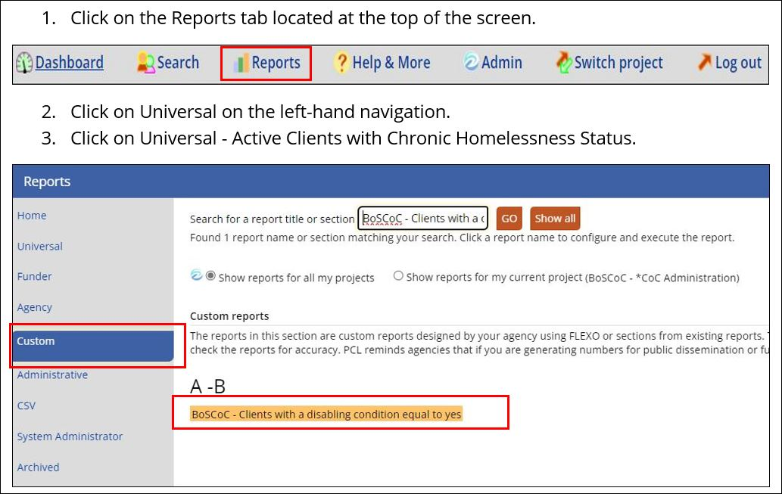
How to run the Custom report
Please note that only users with report access can run reports in VESTA.
Run the report for the project you are logged into so you will be able to click on the client's public id and go directly to the client to record a quick screen.

Slide 9
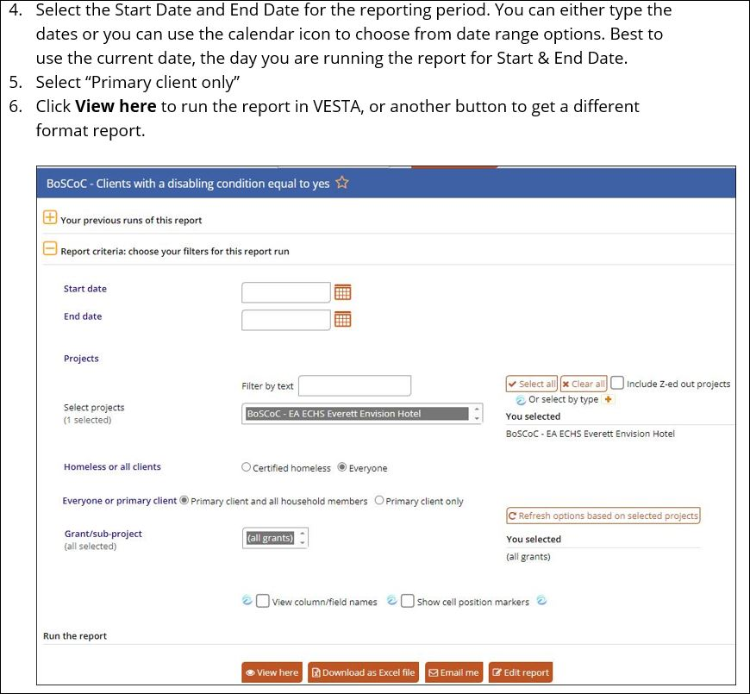
How to run the Custom report - cont.

Slide 10
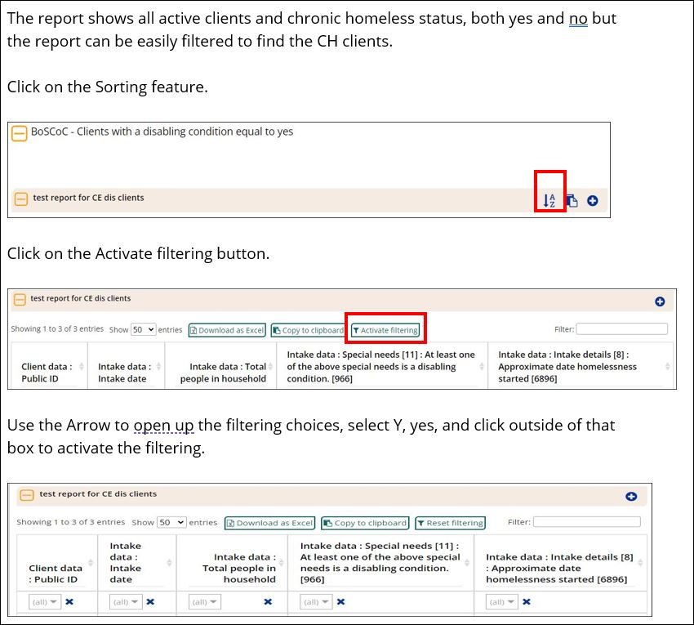
How to run the Custom report - cont.

Slide 11
Two-step CE Application Process
CE Quick Screen
Coordinated Entry
Enrollment and Assessment
Keeps CE Prioritization list manageable
Saves time by screening out clients who are most likely to self-resolve and never be pulled for an opportunity through CE
Asks for household's consent to be added to CE project, explains how their information could be shared with providers
Staff persons from SO, ES, and EA ES will have access to the CE project
Be responsible for completing it for all referred clients at their project

Slide 12
EA Family Shelter Data
EA ETO CH clients will have their Screening data entered into VESTA
Clients that score 16 or higher and consent to being added to the CE project will be referred to CE
EA Family Shelter data will be imported to VESTA nightly*
A pending intake will automatically be generated based on the responses collected for the EA Client CE Quick Screen
* Sometime the import may take a little longer

Slide 13
EA Family Shelters
Record a CE Quick Screen for Head of Household Clients only
Households with medium to high scores are referred to the CE project for a full CE Enrollment and Assessment, to be conducted by the referring organization with the client
In general, households that score less than 16 on the CE Quick Screen are not eligible to be referred to the CE project and the case manager must prioritize non-CE housing options.
  *If a household is a youth household (HoH is ages 18-24) or only in need of start-up cost assistance, they will be automatically referred to CE regardless of their score.
Notes:
If a household is determined to be “housing ready” or a youth (unaccompanied minor between 12 and 17 or young adult up to age 24, provided no one else in the household is over 24 years old) they may score less than 16 and still be referred for a full CE Assessment.

Slide 14
EA Family Shelter Data
Only EA households with an adult that has a disabling condition should complete the CE process
EA ETO clients may have their Quick Screen completed in VESTA
EA clients are all eligible for HomeBASE, a robust state-funded project that can provide ongoing rental assistance similar to a RRH project.
  EA clients will not be referred to CoC/ESG RRH projects; they should utilize HomeBASE as RRH instead
Clients that score 16 or higher will automatically be referred to CE
EA Family Shelter data will be imported to VESTA nightly
A CE pending intake will automatically be generated based on the responses collected in the CE Quick Screen

Slide 15
EA VESTA CE users
Providers will have a limited number of users that will have access to VESTA and the CE project
These users will work with households fill out the CE Quick Screen, and if household is deemed eligible will also complete the CE Enrollment and CE Assessment with them

Slide 16
CE Client list by user role
Active clients
Supervisors* see the entire list of all active households in the CE project. This is a small group of people who help the system run, like the regional Navigators.
Regular users only see clients who have been served by other projects to which the user has access
*Youth Navigators get limited access to CE to only see YHDP clients and clients from other projects they have access to

Slide 17
Regional CE Housing Navigators
Each of the four BoS CoC regions has an agency that is a subrecipient of the CoC’s Coordinated Entry grant
As a CE subrecipient, these agencies oversee facilitating the CE system in their region
Regional Navigator makes referrals to project vacancies, as well as support providers in their region with general CE matters
When screening households for vacancies, Regional Navigators will contact households to confirm eligibility & collect eligibility documentation before sending a referral to a housing provider*
  *(Note: This documentation review is preliminary, and housing providers must do the ultimate check to confirm documentation is adequate before enrolling a household).

Slide 18
Regional CE Housing Navigators (cont.)
In certain circumstances, the CE Regional Navigator will be directly responsible for administering the Quick Screen, Enrollment, and Assessment with clients (households that are not connected to an ES or SO project in the BoS)
Monitor their Region for newly referred applicants who do not have a full CE Assessment completed and engage with the referring agency to ensure it is completed in a timely manner

Slide 19
Quick Screen – step one
The Quick Screen’s purpose is to keep the CE registry at a reasonable level
The score will determine if the client will be sent to the CE project
Clients sleeping in a place not meant for human habitation will be sent to the CE project with the highest possible QS score of 46
Case Managers should update Quick Screen record if answers change, especially about start-up costs
Clients who are only in need of start-up costs and have a unit identified will be automatically referred to CE but only referred to opportunities that cover start-up costs only

Slide 20
Prior Living situation – Very Important!
A household entered into a Street Outreach project or Emergency Shelter that was not homeless the night before, their CE intake should not be completed until the next day

Slide 21
Prior Living situation
To be eligible for CE, Category 1 homeless households must be homeless for at least one night
  If a household entered into a Street Outreach or Emergency Shelter project was not homeless the night before, their CE intake should not be completed until the next day (Category 1 households being entered into the Alternate Portal by Regional Navigators must already have documentation of their homeless status)
When completing the CE intake the next day, the answer will then reflect the homeless setting they stayed in the night before (place not meant for human habitation, emergency shelter, etc.)
Apart from eligibility, this is important because 1) the Chronic Homeless Estimator pulls from the Approximate Date homelessness started, which is a field only prompted for homeless settings, and 2) the CE assessment assigns points for length of time homeless based on CE intake answers.

Slide 22
Prior Living Situation - continued
This solution is to address when someone is entered into CE and prior living situation was not a homeless setting, but that setting changes during their time in CE. This solution aims to:
  Make sure households get points for time homeless, which are based on CE intake answers
  Get 46 Quick Screen points if they are staying in a place not meant for human habitation
  Assign months of homelessness on Chronic Homelessness Estimator, which looks to updated homeless setting answered in prior living situation of CE intake

Slide 23
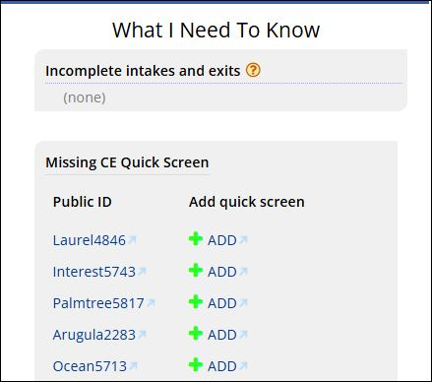
Missing CE Quick Screen – ES Project Dashboard
A household entered into an Emergency Shelter that was not homeless the night before, their CE intake should not be completed until the next day
How to add a
Quick Screen

Slide 24
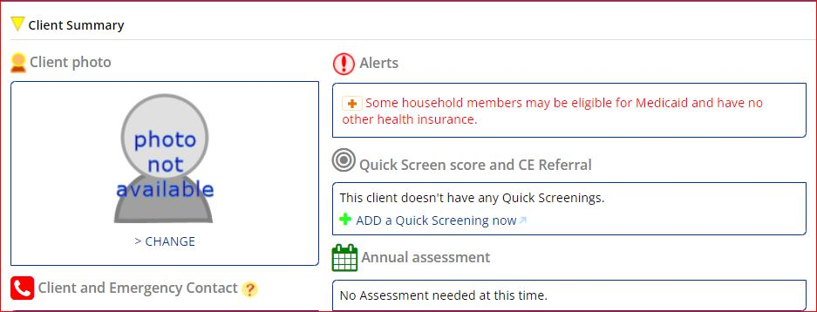
Quick Screening from ES project
How to add a
Quick Screening

Slide 25
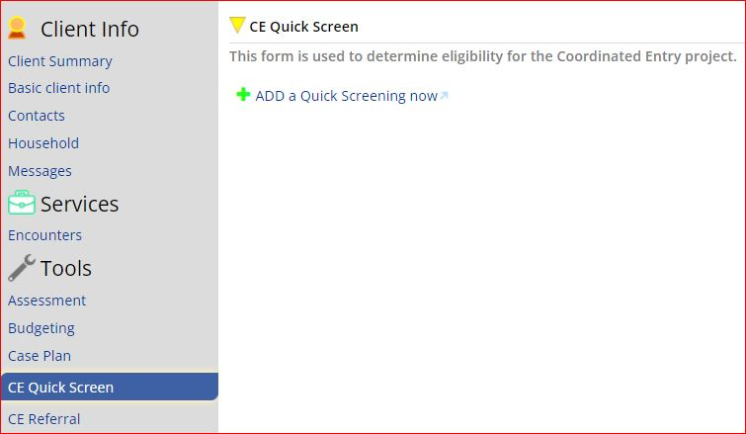
Quick Screening Questions
How to add a
Quick Screening
Notes:
The Quick Screener record can only be deleted, it can not be edited.

Slide 26
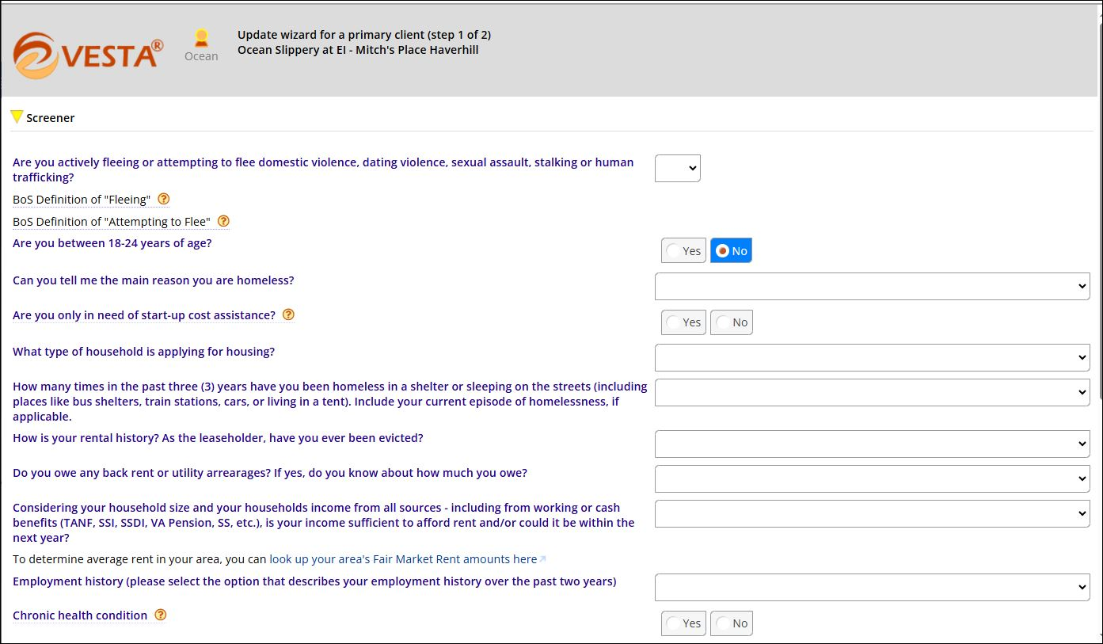
Quick Screener

Slide 27
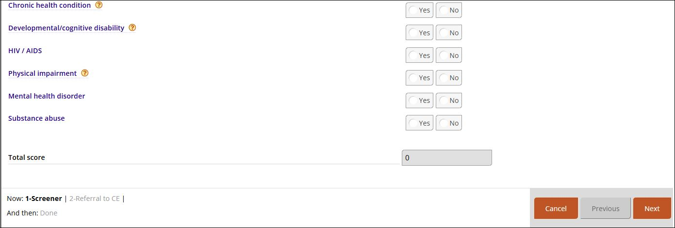
Quick Screener – cont.

Slide 28
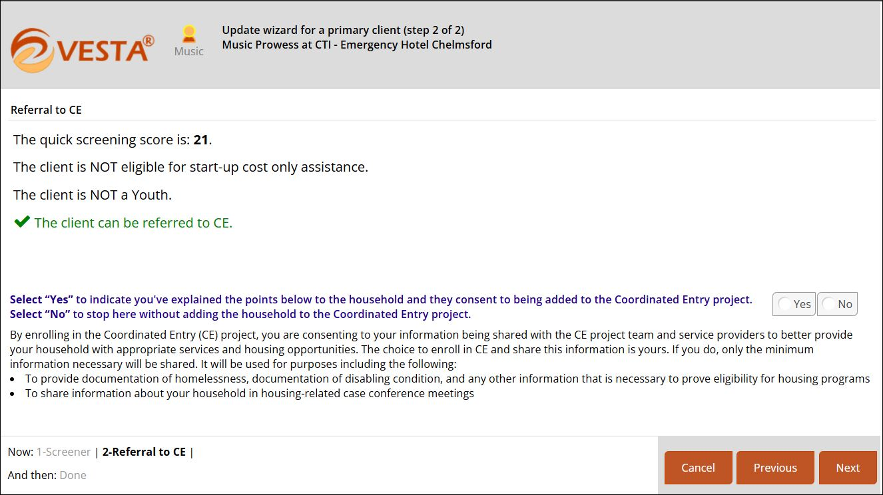
Quick Screener results
Very important!
You must read this information
To the client

Slide 29
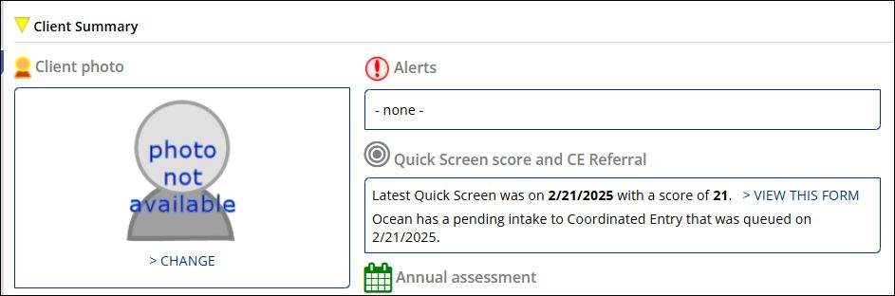
Quick Screening completed
Quick Screening
completed

Slide 30
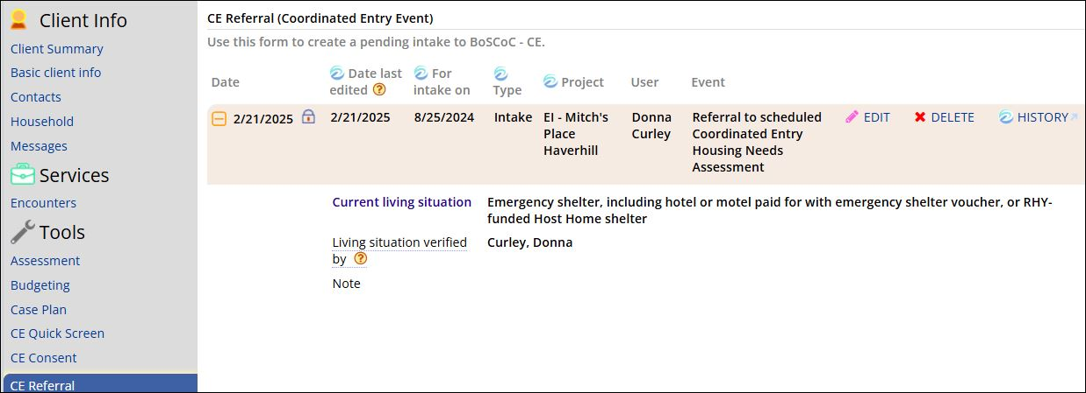
CE Referral
CE Referral
Information
created from
Quick Screen

Slide 31
Completing the CE Assessment
Staff that complete the CE Assessment with eligible households must follow the guidelines below:
Explain questions and ensure understanding
Do not attempt to influence answers
Record the answer that the household provides
  If a household says they have a disabling condition, the assessor should record that and let household know that if they are pulled for a housing opportunity, depending on eligibility criteria for that project they will need to provide documentation of that disabling condition from a clinician at that time. However, please note that no documentation is needed to answer “yes” to disabling condition questions at the time of the CE Enrollment.
  If a client answers “No” to having a disabling condition, but you have verification from a licensed clinician confirming that the Head of Household does in fact have one, you can answer in line with the clinician's diagnosis. This can potentially increase the CE Assessment score, but the provider should remember that ultimately, the household may still be required to acknowledge and provide documentation of this disabling condition if pulled for a vacancy.
  If you have reason to believe a household is not being truthful in their answers to get a higher CE Assessment score, engage the household in conversation and explain the importance of accuracy.

Slide 32
Completing the CE Assessment (cont'd)
Ensure households understand that answers to the Housing Needs and Preferences section of the CE Assessment will be considered with regards to what opportunities they are offered. They will only be considered for the types of housing and features of housing that are selected in those questions. Assessors should make sure households understand to only select the types of housing they are interested in as opposed to blindly opting into everything, as denying a unit will be counted as a strike.
Upon completing the CE Enrollment, staff should notify the household to inform them if any of the provided answers change, explaining that some answers affect their CE Assessment score.

Slide 33
Next steps for case management
Households enrolled in CE and their providers should know that due to these housing projects having scarce resources, not all households added to CE will ultimately be offered housing through the CE system.
BoS CoC wants to emphasize to providers that getting a household enrolled in CE is only one component of a larger plan to support them and help them secure housing. Providers should also prioritize:
  Ensuring households are connected to services that support their immediate needs (case management, shelter access, medical providers, etc), and
  Pursuing other routes to housing and housing applications that could be a fit for the household (CHAMP application for MA public housing, federal public housing opportunities, voucher programs, etc)

Slide 34
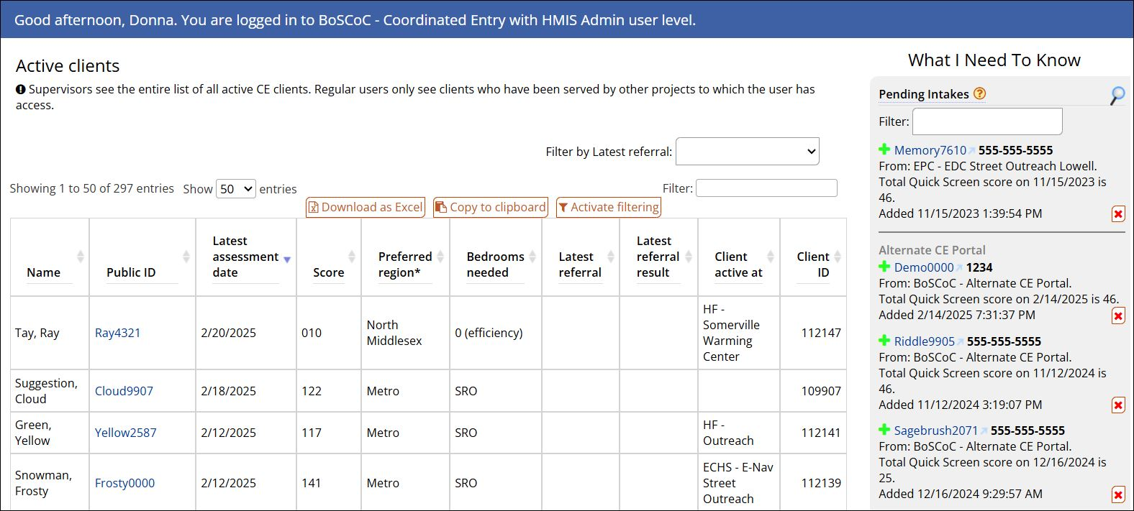
CE Project Dashboard
Clients must be
added to a SO or ES project to be added to this project

Slide 35
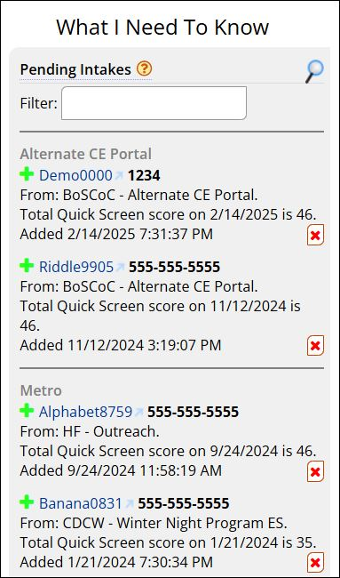
CE Pending Intakes
Select Client Public ID to
complete a CE Intake and
CE Assessment

Slide 36
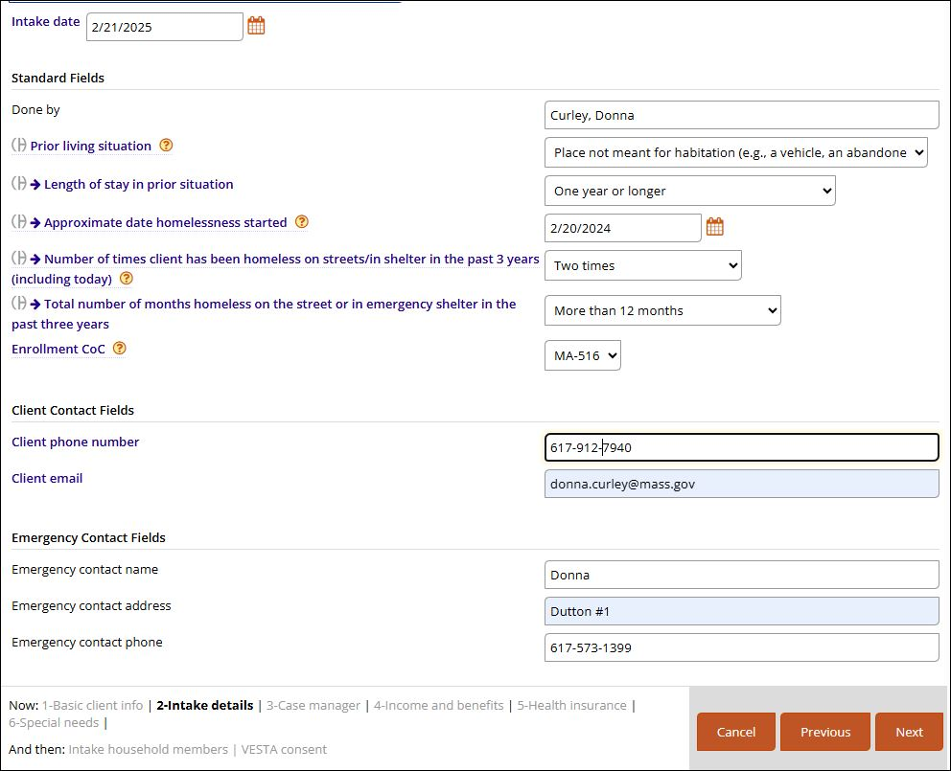
CE Intake
Very important!
Fill in Client phone number
& Email if they have one
Select “Next” and complete the remaining steps
Notes:
Use Case Managers contact information if the client does not have them.

Slide 37
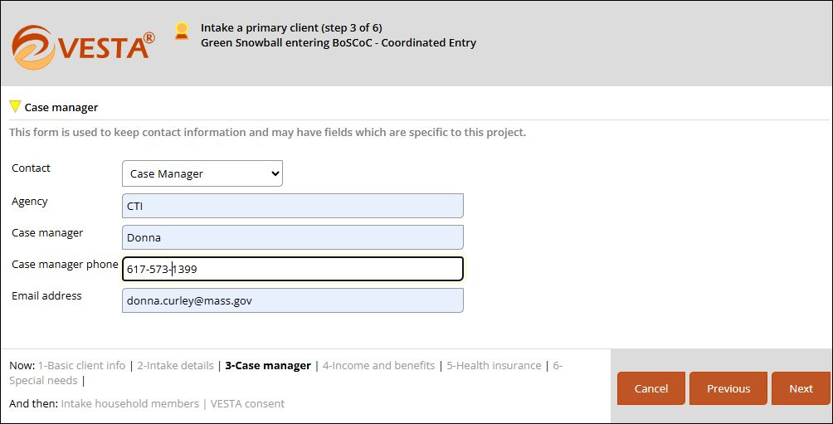
Case Manager
Very important!
Fill in Case Manager’s information
Keep this information up to date!

Slide 38
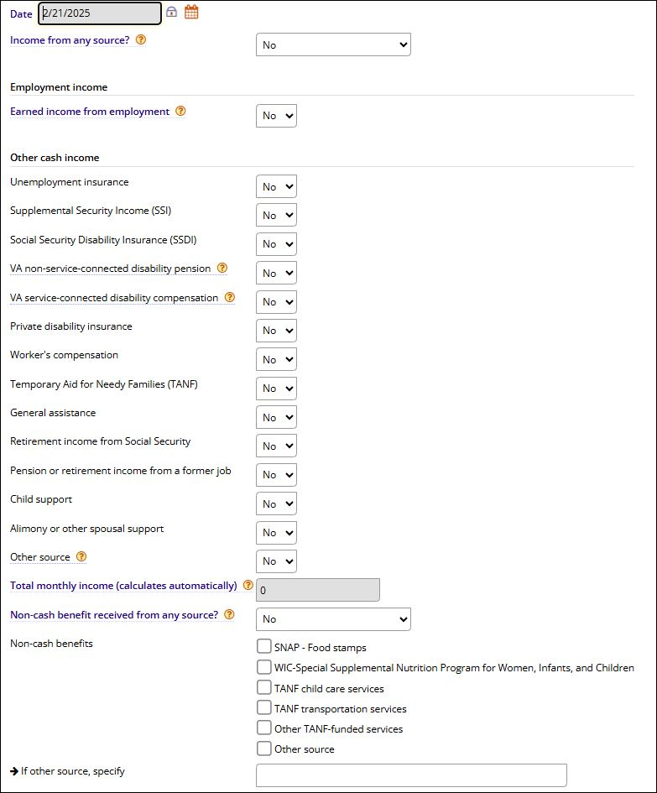
CE Intake - Income

Slide 39
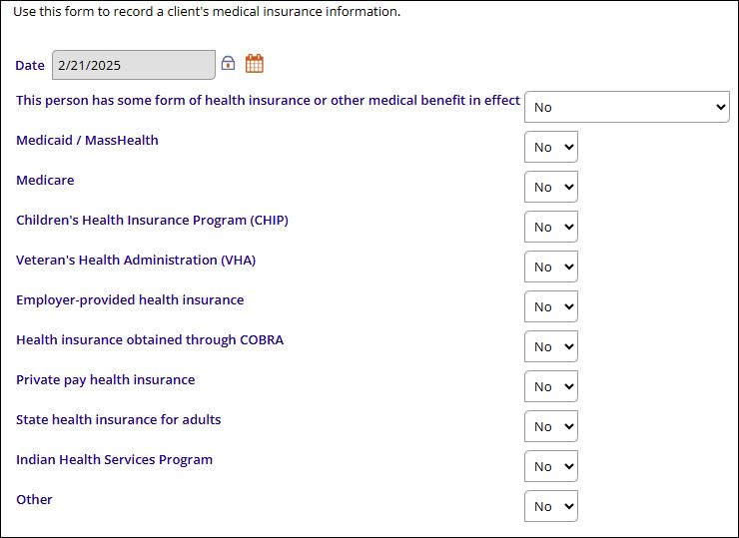
CE Intake – Health Insurance

Slide 40
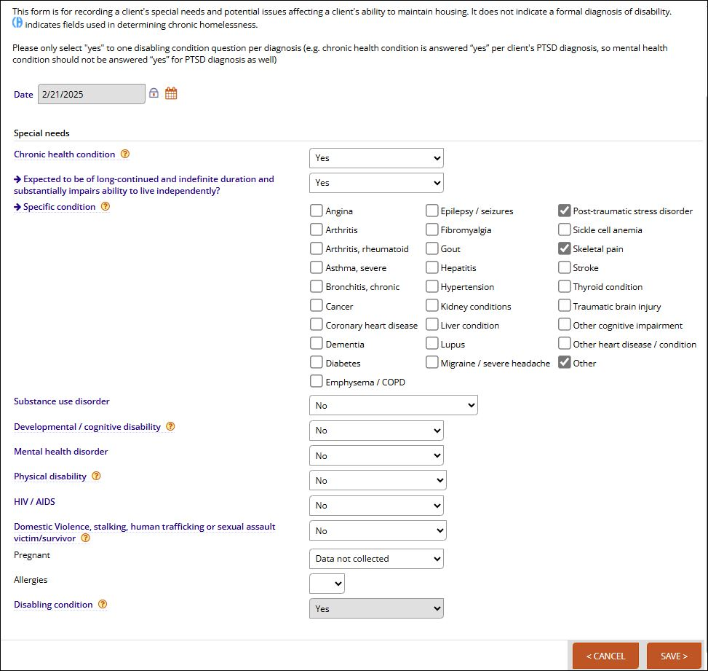
CE Intake – Special needs
Very important!
PTSD note

Slide 41
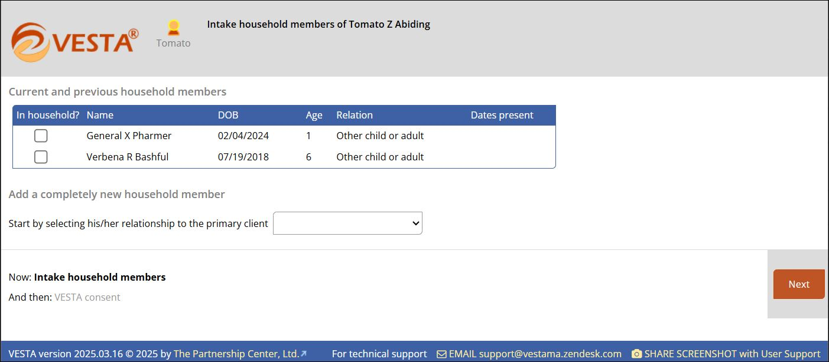
CE Intake continues
Continue adding household members and/or select next to record the client consent
Update!
HH members

Slide 42
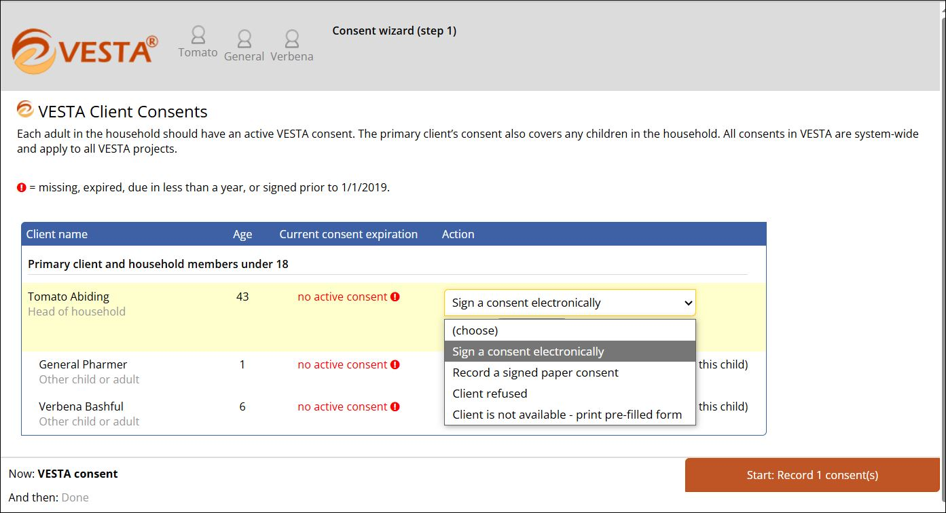
Client Consent
Client Consent
option
Notes:
Continue using existing consent

Slide 43
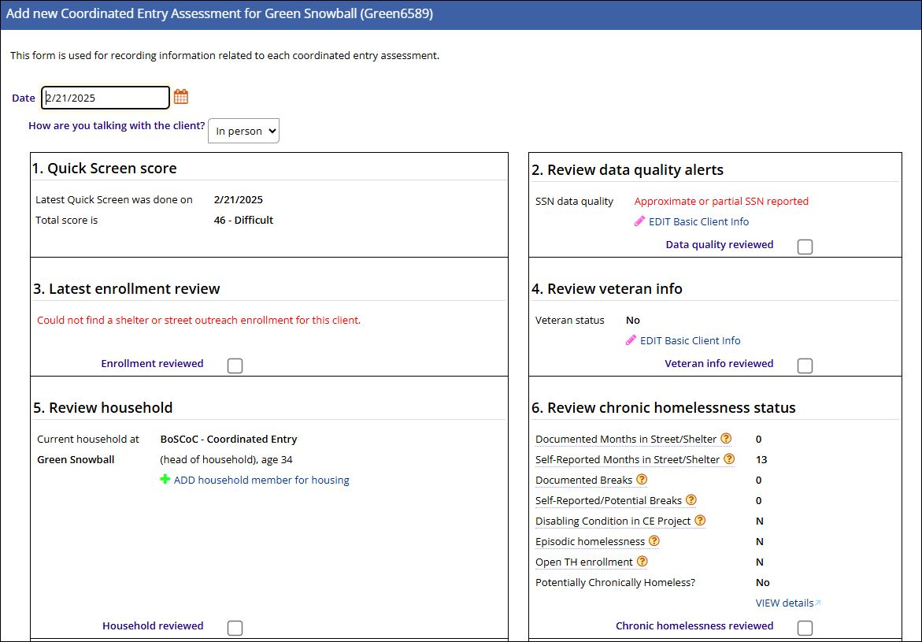
CE Assessment
CE Assessment
Information
starts with a review of client data
Notes:
Note this assessment can be edited or deleted.

Slide 44
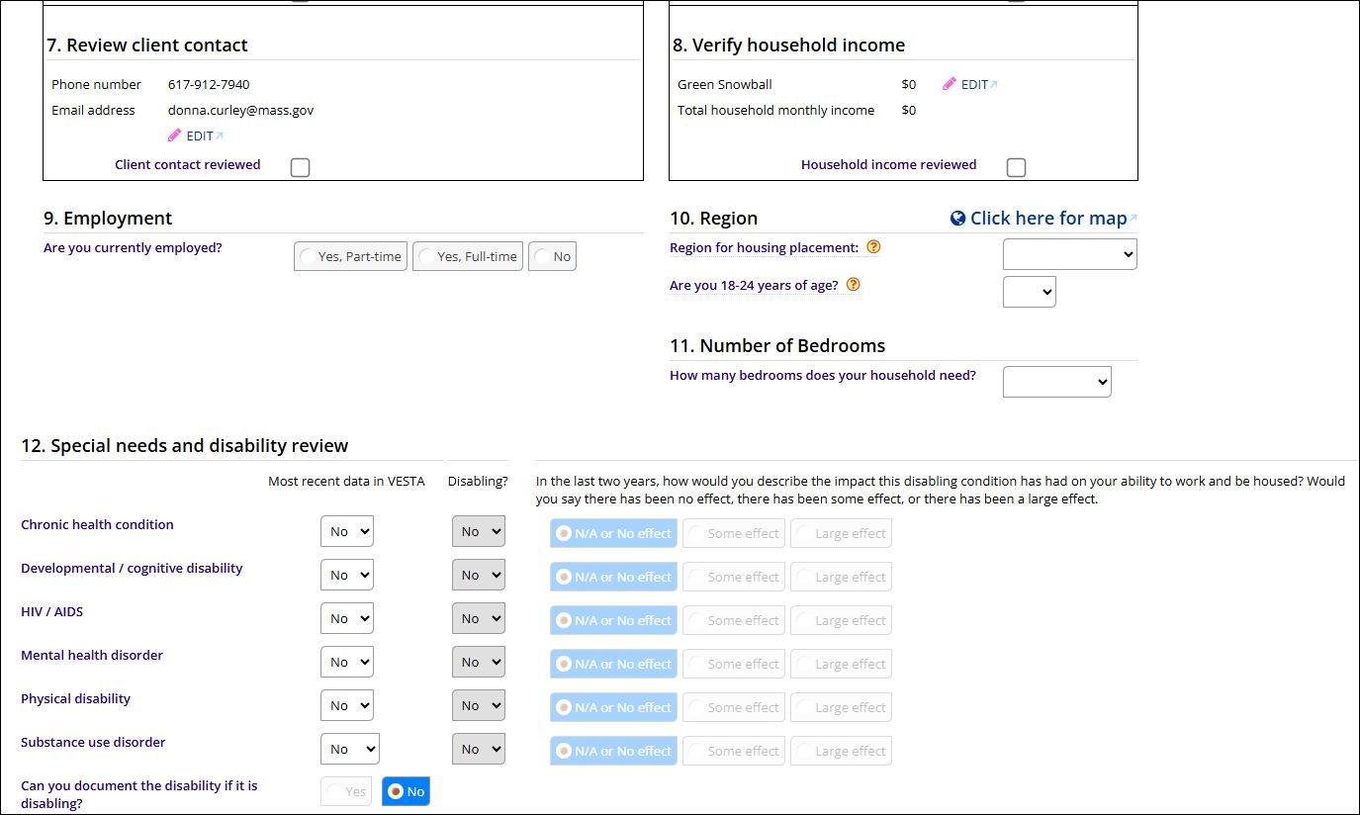
CE Assessment (cont.)
Very important!
You must read this information
To the client and help them select the effect their disability has had on them if that have one or more
Hover over effect choice to see helpful information
Notes:
Note this assessment can be edited or deleted.

Slide 45
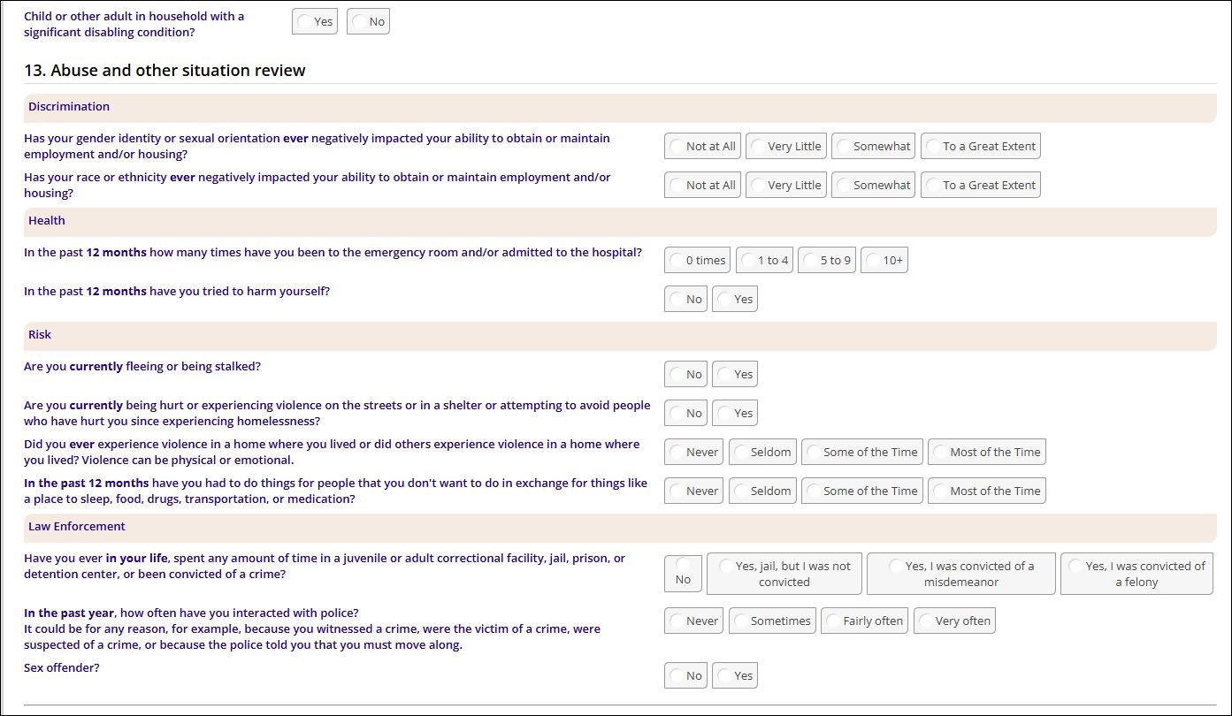
CE Assessment (cont.)
Very important!
You must read this information
To the client and help them select the effect
Hover over effect choice to see helpful information
Notes:
Note this assessment can be edited or deleted.

Slide 46
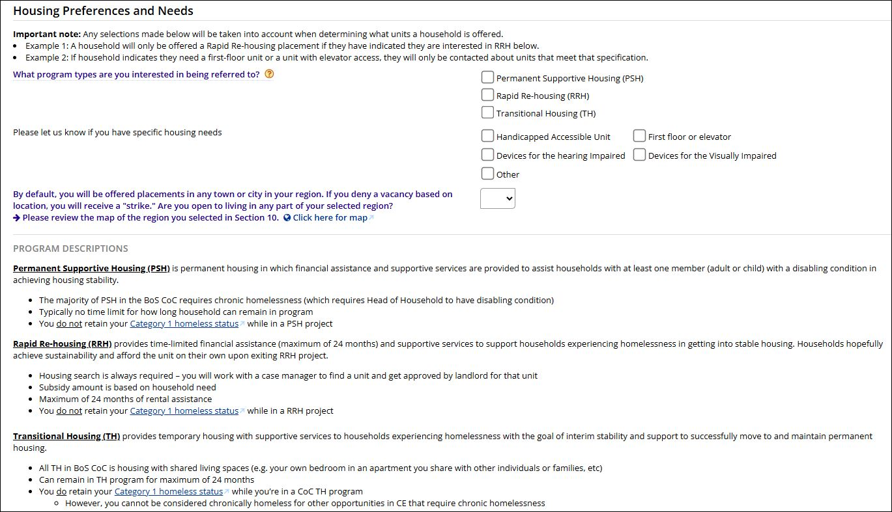
CE Assessment (cont.)
Very important!
Make sure the clients housing preferences are accurate! This is the information used when the VESTAmator makes matches!
Make sure to update if preferences change!
Notes:
Note this assessment can be edited or deleted.

Slide 47
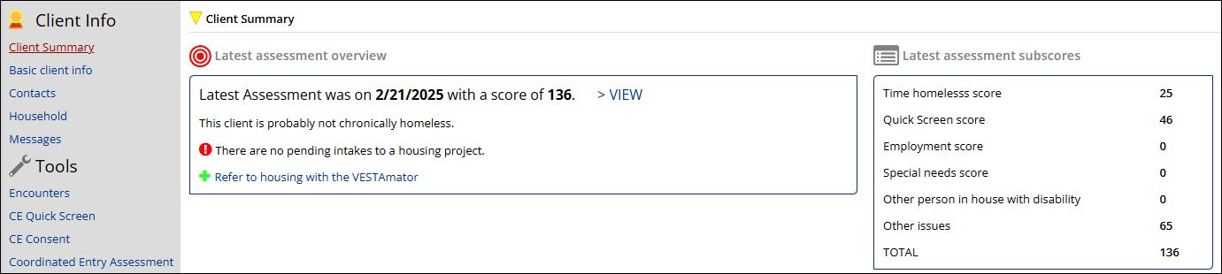
CE Assessment on Client Summary screen
CE Assessment
Information
Very important!
Make sure the client has had the CE assessment completed. If not, they will not be considered for housing openings!
Notes:
Note this assessment can be edited or deleted.

Slide 48
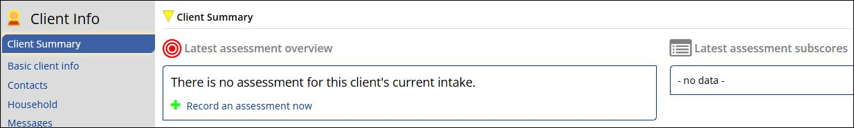
CE Assessment
CE Assessment
Information
link
Very important!
Make sure the client has had the CE assessment completed. If not, they will not be considered for housing openings!
Notes:
Note this assessment can be edited or deleted.

Slide 49
CE EA auto-exit policy -Ongoing Auto-Exit Criteria
CE EA auto-exit anyone without "activity" within the prior 90 days; "activity" is considered:
  an open enrollment in an EA project
  Enrolled in PSH with no move-in date (and still in EA project)

Slide 50
Regional CE Housing Navigator
North Shore
  Marielis Batista, marielis@emmausinc.org
  Al Hanscom, al@emmausinc.org
  Leslie Lawrence, leslie@emmausinc.org
North Middlesex
  James Hogan, jhogan@commteam.org
  Gifty Korankey, gkorankye@commteam.org
  CE Navigator Manager - Shawn Jalbert, shjalbert@commteam.org
Metro
  Leon Moore, lmoore@shcinc.org
West
  Christa Pichler, cpichler@smoc.org
  Maria Larsen, mlarsen@smoc.org
  Maxine Rose, mrose@smoc.org
  DV CE DV (Domestic Violence) Navigator Rebecca Delice, rdelice@shinc.org
  YHDP CE YHDP (Youth Houselessness Demonstration Program) Nicholas DiGiammo ndigiammo@commteam.org
  CE YHDP (Youth Houselessness Demonstration Program) Kerlande Michel Kerlande_Michel@WaysideYouth.org

Slide 51
Support – How to get HMIS help
Use our Zendesk helpdesk email to send in a support request or visit our help site
Send email to support@vestama.zendesk.com
https://vestama.zendesk.com/hc/en-us
Kelly Schlabach, HMIS Lead Coordinator, Kelly.schlabach@mass.gov (617) 573-1387
Andrew Pape, ETO EA HMIS Coordinator, Andrew.pape@mass.gov (617) 573-1234
Donna Curley, HMIS Training Coordinator, Donna.Curley@mass.gov (617) 573-1399
Laura Robertson, HMIS Reporting Specialist, Laura.Robertson@mass.gov (617) 573-1378
Anthony Nappo, Data Management Specialist Anthony.Nappo@mass.gov (617) 573-1374

Slide 52
CE contacts
Questions about CE & CE policies and procedure should be directed to:
Chris Moskal, CE Lead,
chris.moskal@mass.gov 617-573-1461
Karen Byron, MA BoS CoC Supervisor,
Karen.byron@mass.gov 617-573-1344

Slide 53
FY2024 HMIS Data Standards Manual
FY2024 HMIS Data Standards
HMIS Data Standards - HUD Exchange
Notes:
HMIS Data Standards - HUD Exchange

Slide 54
Important take away
It is important to make sure the clients understand for them to be housed; they MUST have their documents ready!
The housing resources are extremely scarce and there are many that need to be housed
The clients that will be housed the quickest are the clients they have ALL their documents ready!
BOSCoC CE Policies and Procedure document link

Slide 55
Questions?

Slide 56
Thank you!

Slide 57

Welcome to VESTA
Virtual Electronic Service Tracking Assistant
We can’t wait to show you how awesome our updated CE workflow is!
https://demo.vestama.net/

