Slide 1

Welcome to
VESTA User
Training
2025

Slide 2
Introductions
Name
Agency
Role
HMIS*, database or data entry experience
* Homeless Management Information System

Slide 3
Housekeeping
Logistics
  • 3-hour training session
  • Please stay muted, unless you would like to ask a question
  • Your undivided attention is required:
      Close email and other programs for the best quality
      Silence your phone, do not answer text messages
      Shut the office door
      Inform your staff you are not available during this time
Asking questions
• This training session is for you, so ask questions at anytime, or type your questions
• If you ask questions that are not answered, they will be answered after we review them with our vendor, the Partnership Center or we will ask HUD.
Notes:
The webinar software does record if your active in the session or not. If you are not able to complete the session, we will ask you to register for another session.

Slide 4
Housekeeping - continued
EA Family Shelters will continue to use ETO
HMIS/ETO "Blackout" was Wednesday, September 29, 2021 @ 5pm
HMIS data entry started in VESTA Live Monday, October 4, 2021

Slide 5
Training Objectives
Attendees will learn:
  About the HMIS Data Standards for FY2026
  Confidentiality, Privacy and Security Training
  How to Navigate the VESTA HMIS system
    Record a client entry, update, annual assessment, and exit from a project
    Run basic reports
    Troubleshoot common issues that can cause problems for reporting, if time
Notes:
Poll question What project type(s) do you enter for?

Slide 6
Agenda
Overview
  • The FY2026 HMIS Data Standards
  • Confidentiality, Privacy and Security Training
  • Expectations for all users - Data Quality & Data timeliness
  • Support System overview and who to contact for help
VESTA Live Demonstration
  • Data collection overview for your project type(s)
  • Dashboard, client entry
  • HUD data collection including Disability, Cash/non-cash, Health Insurance
  • Updates and Annual Assessment
  • Report basics

Slide 7
FY2026 HMIS Data Standards and Manuals
HUD Go Live October 1, 2025
FY2026 HMIS Data Standards
HMIS Federal Partner Program Manuals
HMIS Data Collection Transition to FY2026
HMIS Data Standards - HUD Exchange
Notes:
HMIS Data Standards - HUD Exchange

Slide 8
FY2026 HMIS Data Standards – Name
3.01 Name - Client may provide preferred name, “Legal name” not required unless required by the funder (e.g., VA)
  Use a client's full and accurate name whenever possible
  If client doesn’t associate with their legal name, HMIS should reflect the name the client identifies with
  HMIS records are not expected to include “dead names” or otherwise unused legal names
  Rationale - To support the unique identification of each person served
The full first name should be used (e.g., James vs. Jim) and the last name should be recorded as the individual has it recorded on their official legal documents (driver’s license, social security card, etc.).

Slide 9
FY2026 HMIS Data Standards – Social Security Number
3.02 Social Security Number - HUD CoC and ESG, and SAMHSA PATH
Programs require only last four digits of SSN to be required, though are not prohibited from collecting all nine digits
  Collect nine-digit SSN when possible
  CoC and ESG-funded projects not penalized for only collecting the last four digits of the SSN
Any Veteran applying for services from VA funded program, i.e., SSVF must provide an SSN to receive services
Any Veteran who declines to provide an SSN is not eligible for VA funded assistance
Rationale - To support the unique identification of each person served

Slide 10
FY2026 HMIS Data Standards – Race & Ethnicity
3.04 Race and Ethnicity - Combine Race and Ethnicity into single data element. (Eliminate 3.05 Ethnicity data element)
  text box to provide additional detail
Clients' self-identification of one or more of the different racial categories
Staff should review information with active clients at the next appropriate encounter. Verify accuracy and update if incorrect.
Notes:
American Indian, Alaska Native, or Indigenous is defined a person who identifies with any of the original peoples of North, Central, and South America. Examples include, but are not limited to Navajo Nation, Blackfeet Tribe, Mayan, Aztec, Tlingit, etc.
Asian or Asian American is defined as A person who identifies with one or more nationalities or ethnic groups originating in East Asia, Southeast Asia, or the Indian subcontinent. Examples include, but are not limited to Chinese, Indian, Japanese, Korean, Pakistani, Vietnamese, or another representative nation/region.
Black, African American or African is defined as a person who identifies with one or more nationalities or ethnic groups originating in any of the Black racial groups of Africa, including Afro-Caribbean. Examples include, but are not limited to, African American, Jamaican, Haitian, Nigerian, Ethiopian, and Somali.
Hispanic/Latina/e/o is defined as a person who identifies with one or more nationalities or ethnic groups originating in Mexico, Puerto Rico, Cuba, Central and South American, and other Spanish cultures. Examples include, but are not limited to, Mexican or Mexican American, Puerto Rican, Cuban, Salvadoran, Dominican, and Colombian.

Slide 11
BoS CoC HMIS Data Element – Gender
Gender
Client’s self-identification of one or more of the gender categories
Staff should review information with active clients at the next appropriate encounter. Verify accuracy and update if incorrect.
Notes:
Woman (Girl if child) is defined as a woman, or girl in the case of a child under the age of 18.
Man (Boy if child) is defined as a man, or boy in the case of a child under the age of 18.
Culturally Specific Identity (e.g. Two-Spirit) is defined as an identity that is exclusive to a particular culture.
Transgender is defined as a transgender history, experience, or identity.
Non-binary is defined as a person who does not identify exclusively as a man or a woman.
Questioning is defined as someone who may be unsure, may be exploring, or may not relate to or identify with a gender identity at this time.
Different Identity is defined as someone who identifies with another identity that is not listed as a response

Slide 12
BoS CoC HMIS Data Element – Translation Assistance Needed
Translation Assistance Needed
  To understand how many clients need access to translation services
  If so, which languages are most often cited as needing translation
  HMIS end users/staff should collect this field for all clients

Slide 13
BoS CoC HMIS Data Element – Sexual Orientation
Sexual Orientation
  HMIS end users/staff should review information with clients
  Data collection is to begin to understand what disparities may exist
Notes:
The field will be added to the system HUD: CoC Standard Project Enrollment screen and will be displayed for adults and Heads of household who are enrolled in HUD: CoC-PSH-funded PSH and YHDP projects.

Slide 14
Coordinated Entry
All CoC-funded PSH, TH-RRH, and RRH, and all ESG-funded RRH are required to participate
Emergency Shelters
  Record a CE Quick Screen for all Head of Household Clients
  Households with medium to high scores are referred to the CE project for a full CE Vulnerability Assessment and Housing Needs Form to be conducted by the referring organization and their client
  In general, households that score less than 16 on the CE Quick Screen are not eligible to be referred to the CE project. In these cases, the shelter case manager is responsible for establishing a housing plan with the household to identify other appropriate housing placement options

Slide 15
Coordinated Entry
All CoC-funded PSH, TH-RRH, and RRH, and all ESG-funded RRH are required to participate
All Permanent House and Rapid ReHousing projects in VESTA must use the Rental Data form to record unit, landlord, and rental/payment information. This important form will interact with VESTA and the Balance of State Coordinated Entry system in multiple dynamic ways, and will also be important in CoC-wide reporting
Rental Data form(s) only need to be recorded on the Head of Household's record. A new form must be added any time there is a change to any of the data collected on the form

Slide 16
Support – How to get HMIS help
We have acquired a helpdesk system software, Zendesk.
Send email to support@vestama.zendesk.com
https://vestama.zendesk.com/hc/en-us
Kelly Schlabach, HMIS Lead Coordinator, Kelly.schlabach@mass.gov (617) 573-1387
Andrew Pape, EA ETO HMIS Coordinator, Andrew.pape@mass.gov (617) 573-1234
Donna Curley, HMIS Training Coordinator, Donna.Curley@mass.gov (617) 573-1399
Laura Robertson, HMIS Reporting Specialist, Laura.Robertson@mass.gov (617) 573-1378
Anthony Nappo, Data Management Specialist, Anthony.Nappo@mass.gov (617) 573-1374

Slide 17
Massachusetts Balance of State CoC
Massachusetts CoC Map
Continuum of Care and Continuum means the group organized to carry out the responsibilities required under the CoC Program Interim Rule (24 CFR Part 578) and comprises representatives of organizations, including nonprofit homeless assistance providers, victim service providers, faith-based organizations, governments, businesses, advocates, public housing agencies, school districts, social service providers, mental health agencies, hospitals, universities, affordable housing developers, law enforcement, and organizations that serve people who have previously and are currently experiencing homelessness to the extent that these groups are represented within the geographic area and are available to participate.
CoC Program refers to the HUD funding source which provides housing and/or service grant dollars.
Massachusetts Balance of State Continuum of Care Programs

Slide 18
Questions?
Notes:
Poll question Does your Agency require you to take training on Client Confidentiality, Privacy and Security?

Slide 19

Next up
Confidentiality, Privacy and Security slides
Notes:
GoTo next preso Poll question Does your Agency require you to take training on Client Confidentiality, Privacy and Security?
Privacy and security training link: https://youtu.be/C0f--OVw6Vc
Back up link: https://youtu.be/IREMIA6Z4ms

Slide 20
Break Time!
Stretch Break
Be back at 10:30am
Thank you!

Slide 21

Welcome to VESTA
Virtual Electronic Service Tracking Assistant
We can’t wait to show you how easy to use and awesome our new HMIS system is!
https://demo.vestama.net/
Notes:
Poll question Are you back from the break?

Slide 22
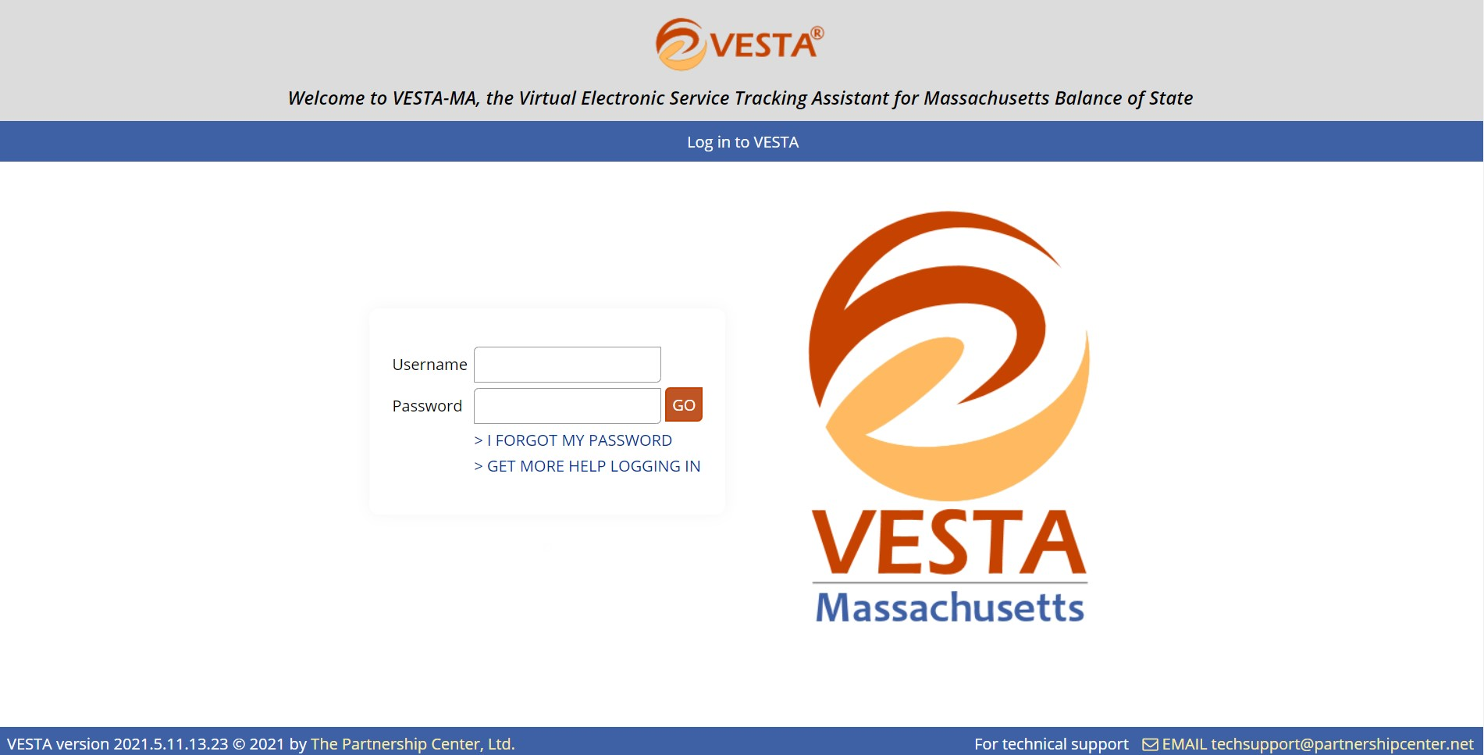
VESTA Login Screen
Notes:
Training Poll Questions – before live db demo

Slide 23
Questions?

Slide 24
Thank you!

